Slide 1
SAP BTP Extension Suite Training
Day 22
Anubhav Oberoy
www.AnubhavTrainings.com
Follow excellence with sheer passion

Slide 2


DISCLAIMER
The training content and delivery of this presentation is confidential, and cannot be recorded, or copied and distributed to any third party, without the written consent of Anubhav Trainings

Slide 3
Agenda – Day 22
01
Scanner use case
02
Variables
03
Create SO App

Slide 4

Use case 2
Persona:
Name: Priya
Age: 32
Role: A health-conscious mother of a 6-year-old boy
Goal: To ensure her son eats healthy snacks, avoiding high sugar, additives, or allergens
Scenario:
Priya is grocery shopping on a busy weekday afternoon. Her son loves trying new snacks, but Priya is always worried about hidden sugars, preservatives, and allergy-triggering ingredients. Reading tiny labels on packaging is time-consuming and frustrating.
Key Features of the App:
- Barcode scanning
- Instant nutrition info from Open Food Facts
- Allergen warnings
- Healthy alternatives
- Kid-focused nutritional grading
Benefit:
Priya saves time and makes informed decisions, ensuring her son enjoys tasty snacks without compromising health.

Slide 5
Open APIs
Open Food Facts offers a comprehensive API that allows developers to access a vast database of food product information, including details such as ingredients, nutritional content, allergens, and labels. This open-source database is continually enriched by contributors worldwide, making it an invaluable resource for applications focused on health, diet tracking, food research, and consumer information. citeturn0search0
Key Features of the Open Food Facts API:
- Extensive Data Access: Retrieve detailed information about food products, including ingredients, nutritional facts, allergens, and more.
- Global Coverage: Access data from a wide range of products sourced from various countries, providing a diverse and comprehensive dataset.
- User Contributions: Benefit from a continually growing database, as users worldwide contribute by adding new products and updating existing information.
- Integration Flexibility: Utilize the RESTful API to seamlessly integrate food product data into mobile apps, research projects, software, or diet-based web services.
https://world.openfoodfacts.net/api/0/product/8904004400083?fields=product_name,nutriments,image_front_url
Sample products –
8901764061257
8901262200189
8901063029279
8904004400083

Slide 6
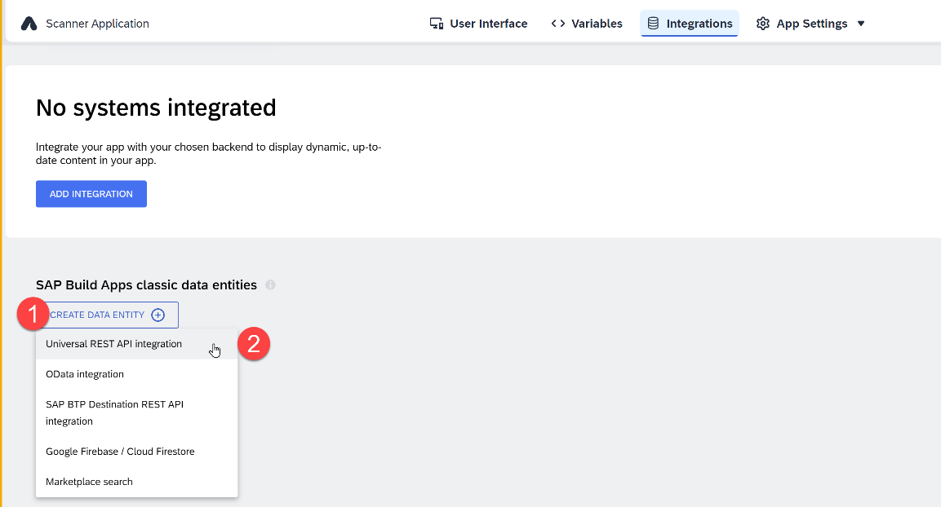
Integrations – REST API
A REST API direct integration type data resource essentially tells SAP Build Apps how a specific, JSON-format HTTP REST API can be accessed. It defines things like a base URL, headers, query parameters, available methods, schemas, and so on. You can create new external data resources and edit existing ones via the Data button in the top toolbar. The resource configuration is split into base configuration and method configurations for GET collection, GET record, POST, PUT/PATCH, and DELETE.

Slide 7
Parts
https://world.openfoodfacts.net/api/0/product/8901063029279?fields=product_name,nutriments,image_front_url

Slide 8
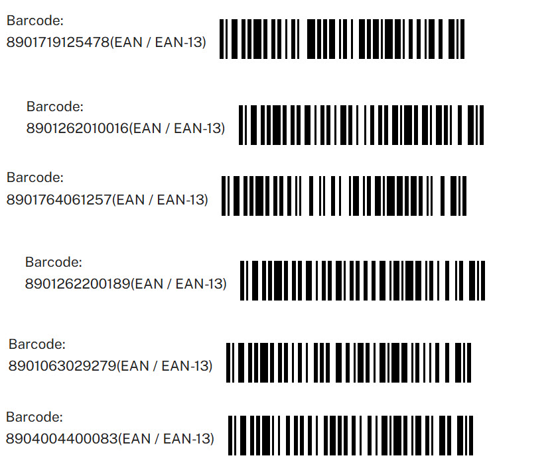
Test data

Slide 9
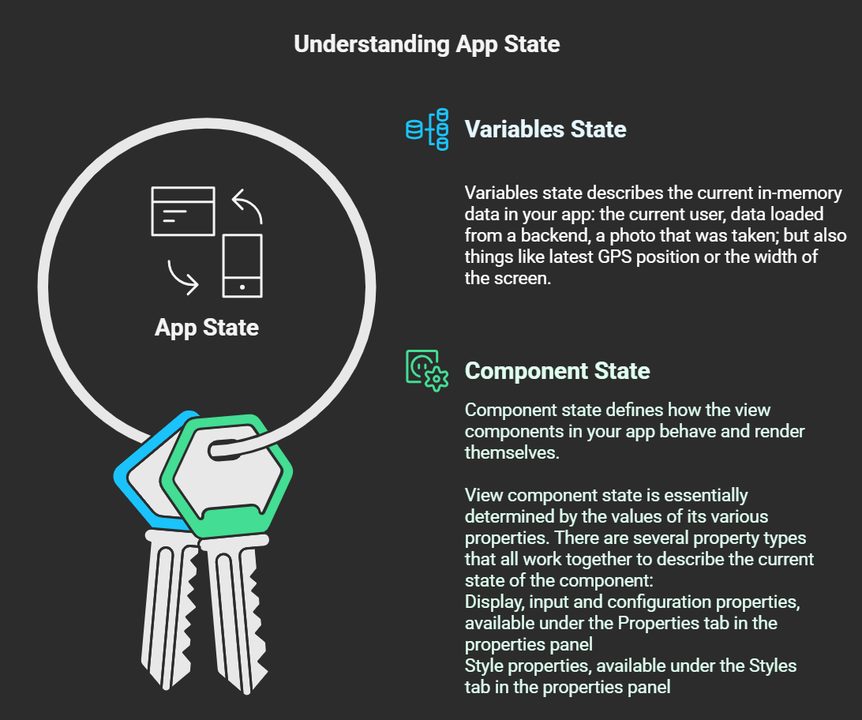
App State in SAP Build Apps
Every SAP Build Apps app that is running has what is called app state. It consists of two interlinked concepts: variables state and component state.

Slide 10
Types of Dynamic variables
Dynamic variables are the backbone of your app logic. For the most part, the data they contain at any given time is determined by what flow functions have been called during the app runtime so far.
Page variables
Page variables exist in the context of a single page. When a page is removed from the navigation stack, its page variables are reset.
Data variables
Data variables are like page variables, but their schema is defined by the data resource they are linked to. They also come with default logic that loads the associated data from the backend and stores it in the data variable.
App variables
App variables exist in the global context of the app. When the app opens for the first time, or is closed and reopened, app variables are reset.
Page Parameters
Page parameters can only be of the text type. Page parameters are read-only variables that can be set with the Open page flow function for the new page, e.g. ID of a product for a product details page.
Theme variables
Theme variables define how the various view components look, giving you an easy way to change the whole look-and-feel of your app.
System variables
System variables define properties of the current app and the device its running on. They cannot be affected by the user directly, but change when the underlying property changes.

Slide 11
Create destination to simple OData Service
Type=HTTP
HTML5.DynamicDestination=true
Authentication=NoAuthentication
Name=AnubhavOData
WebIDEEnabled=true
sap.processautomation.enabled=true
sap.build.usage=odata_gen
ProxyType=Internet
URL=https://orderscapapp.cfapps.eu10.hana.ondemand.com/service/OrderManagement
Appgyver.Enabled=true
sap.applicationdevelopment.actions.enabled=true
Images:
https://ui5.sap.com/test-resources/sap/m/demokit/cart/webapp/localService/mockdata/images/HT-1020.jpg

Slide 12

Scenario – Shopping cart App
🧑‍💼 Persona: Jack Dowson – Procurement Manager
Age: 34
Location: Chicago, USA
Industry: Manufacturing
Role: Manages procurement for factory suppliers
Goals:
  Quickly find suppliers
  Ensure availability to take orders based on size
  On-board new suppliers with approvals
🎯 Objective
Design a user-friendly mobile app that allows Alex to:
Browse available suppliers
View detailed information
Add New suppliers
Edit Suppliers data

Slide 13

What We Did
Let’s Summarize

Slide 14

www.anubhavtrainings.com
Thank You
End of Day 20

Slide 15


We’re committed to empower you to be
#FutureReady
through powerful training solutions.
We build the workforce of the future.
260+
Corporate Clients
60,000+
Learners Trained
26000+
Learners Placed
FREE WEBINARS
Sign up for free webinars with industry experts every fortnight!
Enroll Now!
Contact us today!
https://anubhavtrainings.com

